Slide 1
CLIMATE CHANGE:KEYPOINTS
Post OLLI
John G Thomas, PhD, Professor Emeritus
May 14,2019
“Climate Change and Potable Water: The impact of Microbial Contamination”

Slide 2
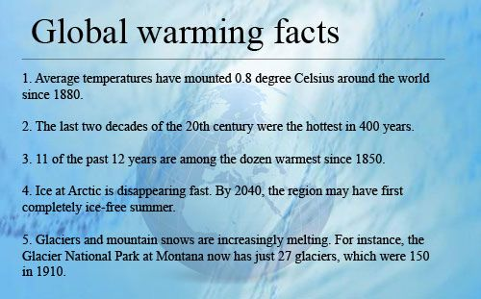
“FIGURES DON’T LIE, LIERS CAN FIGUTE”

Slide 3
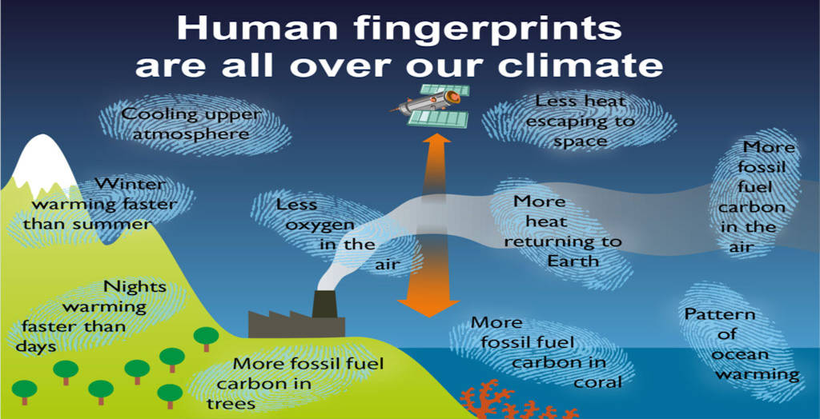

Slide 4
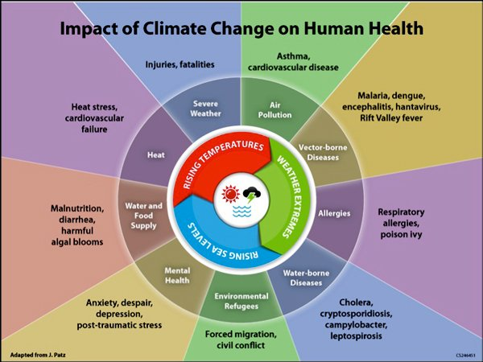

Slide 5
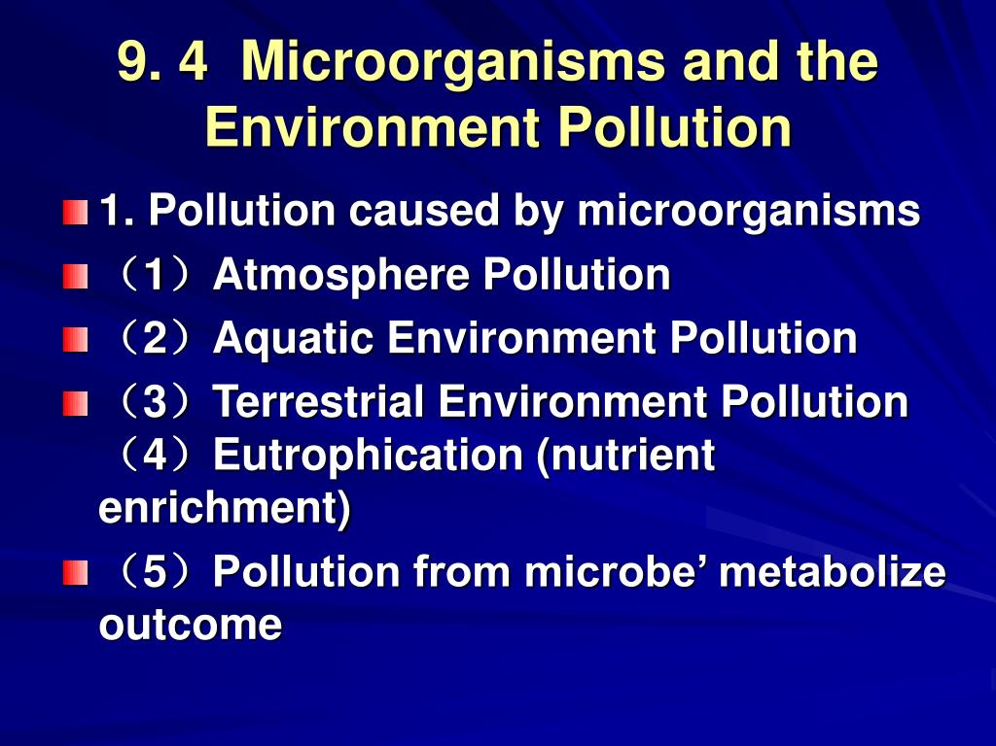

Slide 6
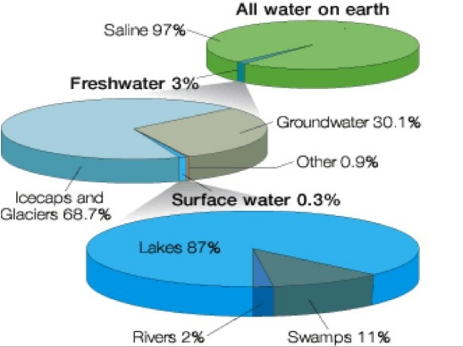

Slide 7
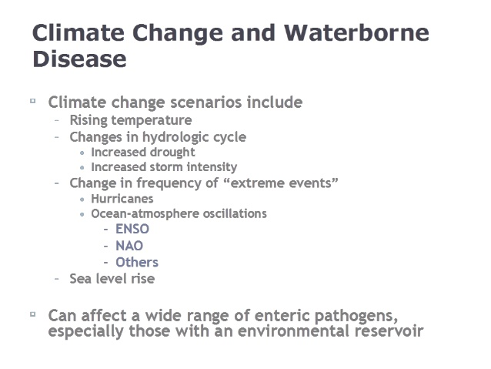
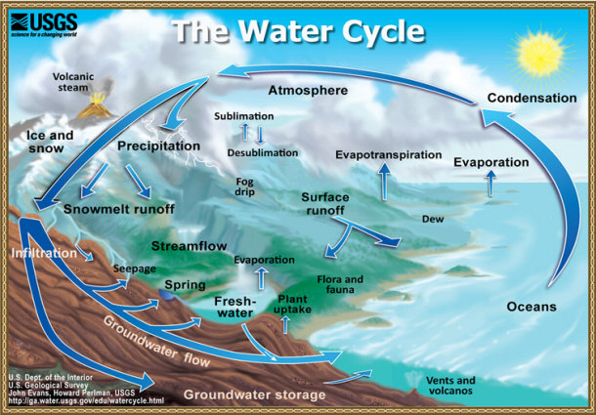

Slide 8
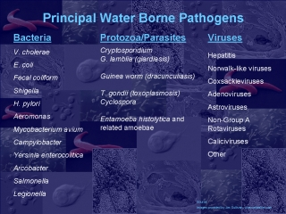
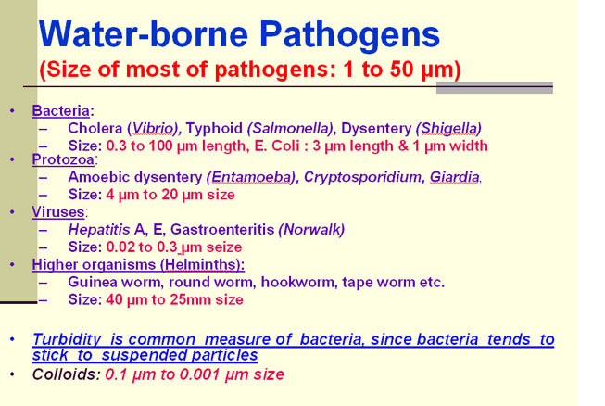
WH0 3.4 MILLION DIE/YEAR
UN 4,000 CHILDREN/DAY
WATER RUN OFF/STAGNATION

Slide 9
MILESTONES OF CLIMATE CHANGE
Remember the number 2 degrees C. 3.6 F???
Asia pacific is the Key
Water born pathogens leading cause of death world wide
4 out of 10 people don’t have potable water
Lakes as reservoirs and water run off are key opportunities
Pollution could be micro-centric with water microbiota recognized: fungi and algae. ONE HEALTH.
Increasing assault on water supply. Diminish and political undercurrent

Slide 10
WATER WARS. Who Owns the Earths Water?
Global water consumption is doubling every 20 years
WHO predicts 48 nations will face sever shortage by 2025
World Bank predicts two-thirds of worlds population will run short of fresh drinking water in 2025.
Hotspots: Middle East , Northern China, Mexico, California, 24 countries in Africa.
Last century: oil was fluid of interest. This century, water is the fluid of interest. BLUE GOLD!!

Slide 11
WATER WARS: Who Owns the Earths Water
I. Privatization: multinational corporations have gained access to once publicly-owned water supplies. Profits of water industry now amount to 40% o the oil sector, $1 trillion. Europeans, primarily French, dominate.
II. Bottled water industry: $25 billion/yr annual growth, 20%. Nestle. Coca-cola, PepsiCo, and Danone. Securing water rights, harm to environment.
III. Bulk Export. Transport fresh water in bulk. Water will be moved as oil has been. Pipes, ships.
IV. WTO, NAFTA, IMF

Slide 12
WATER WARS: 2Doctrines govern Surface water rights in US
East. Riparian Doctrine. “Reasonable Right”, close to water.
West. “Prior appropriation Doctrine”, away from water, needed to move water was based on who used water first. Initially, who asked for US permit.
Tribal access.???? Treaties????.
US Army Corp of Engineers. Dams and spill-ways.

Slide 13
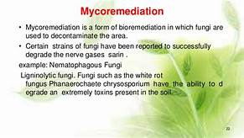
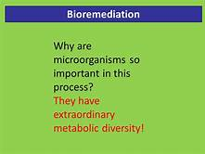
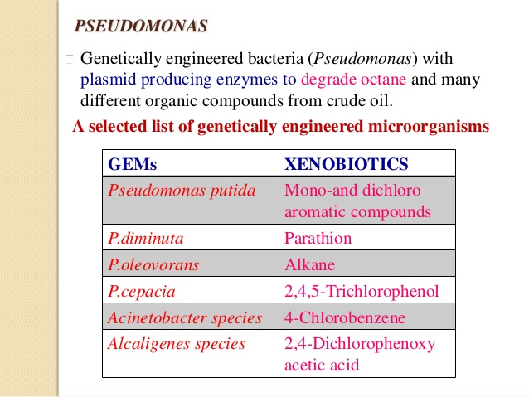

Slide 14
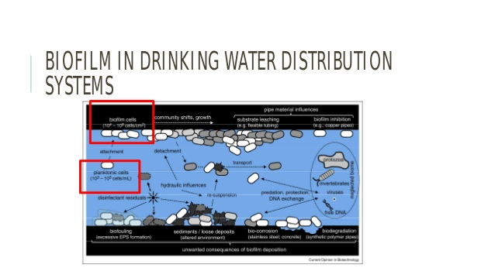

Slide 15
CONCLUSION
WATER IS THE 21 ST CENTURY BLUE GOLD
THERE IS NOT ENOUGH,CATALYZED BY CLIMATE
NEXT 10 -15 YEARS ARE CRITICAL
MULTI NATIONAL INTEREST WILL RULE
US WATER SYSTEM IS OLD, INADEQUATE AND TREATY DEFINED. BIOFILMS
MICROBES ARE BOTH UNREGOGNIZED HAZARDS AND BENEFITS. HARNESS GENETIC STRENGTH

